Slide 1
Series: Just Fix It!
“Forewarned is Forearmed” (Part 4).
John Staiger
Morningside Church of Christ
Wednesday 15 June2022
Bible Class
Broadcast from 42 Leslie Avenue, Auckland, Aotearoa/NZ.
www.morningsidechurchofchrist.org.nz

Slide 2
Series: Just Fix It!
“Forewarned
is
Forearmed”
(Part 4).

Slide 3
Series: Just Fix It! “Forewarned is Forearmed” (Part 4).
The Problem of Isolation

Slide 4
Series: Just Fix It! “Forewarned is Forearmed” (Part 4).
The Problem of Isolation
It can happen to any of us.

Slide 5
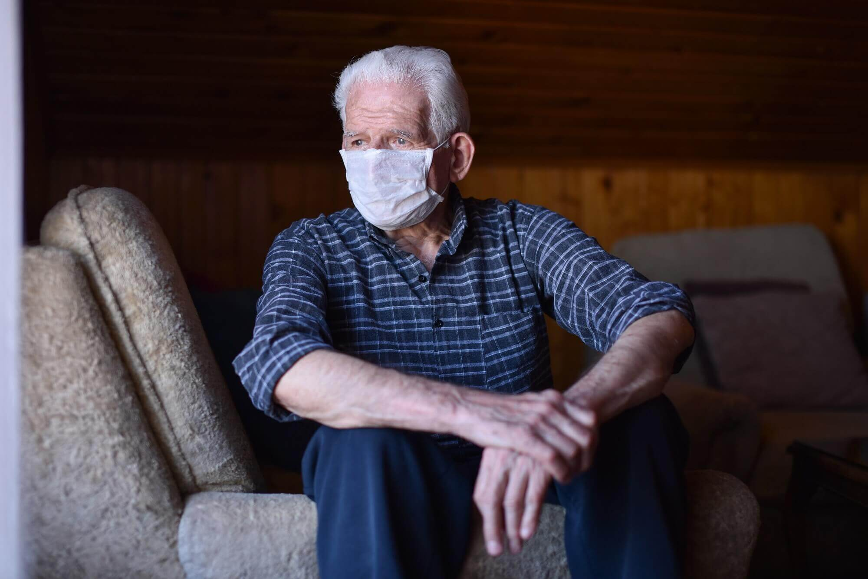
Series: Just Fix It! “Forewarned is Forearmed” (Part 4).
The Problem of Isolation
It can happen to any of us.
Suddenly:

Slide 6
Series: Just Fix It! “Forewarned is Forearmed” (Part 4).
The Problem of Isolation
It can happen to any of us.
Suddenly:
Death of a loved one.

Slide 7
Series: Just Fix It! “Forewarned is Forearmed” (Part 4).
The Problem of Isolation
It can happen to any of us.
Suddenly:
Death of a loved one.
Family breakup

Slide 8
Series: Just Fix It! “Forewarned is Forearmed” (Part 4).
The Problem of Isolation
It can happen to any of us.
Suddenly:
Death of a loved one.
Family breakup
Moving house.

Slide 9
Series: Just Fix It! “Forewarned is Forearmed” (Part 4).
The Problem of Isolation
It can happen to any of us.
Suddenly:
Death of a loved one.
Family breakup
Moving house.
Loss of mobility.

Slide 10
Series: Just Fix It! “Forewarned is Forearmed” (Part 4).
The Problem of Isolation
It can happen to any of us.
Suddenly
Gradually

Slide 11
Series: Just Fix It! “Forewarned is Forearmed” (Part 4).
The Problem of Isolation
It can happen to any of us.
Suddenly
Gradually
Kids leaving home.

Slide 12
Series: Just Fix It! “Forewarned is Forearmed” (Part 4).
The Problem of Isolation
It can happen to any of us.
Suddenly
Gradually
Kids leaving home.
Friends moving away.

Slide 13
Series: Just Fix It! “Forewarned is Forearmed” (Part 4).
The Problem of Isolation
It can happen to any of us.
Suddenly
Gradually
Kids leaving home.
Friends moving away.
Contemporaries passing away.

Slide 14
Series: Just Fix It! “Forewarned is Forearmed” (Part 4).
The Problem of Isolation
It can happen to any of us.
Suddenly
Gradually
Kids leaving home.
Friends moving away.
Contemporaries passing away.
Relationships change.

Slide 15
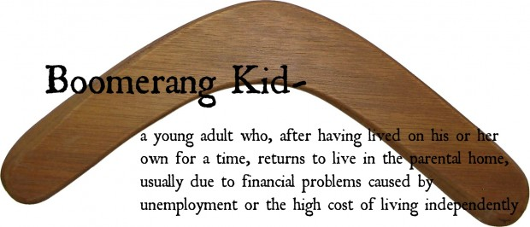
Series: Just Fix It! “Forewarned is Forearmed” (Part 4).
The Problem of Isolation
It can happen to any of us.
Suddenly
Gradually
Comes and goes

Slide 16
Series: Just Fix It! “Forewarned is Forearmed” (Part 4).
The Problem of Isolation
Differing impacts—

Slide 17
Series: Just Fix It! “Forewarned is Forearmed” (Part 4).
The Problem of Isolation
Differing impacts—
Some thrive

Slide 18
Series: Just Fix It! “Forewarned is Forearmed” (Part 4).
The Problem of Isolation
Differing impacts—
Some thrive.
Some see it as temporary.

Slide 19
Series: Just Fix It! “Forewarned is Forearmed” (Part 4).
The Problem of Isolation
Differing impacts—
Some thrive.
Some see it as temporary.
Some go into depression.

Slide 20
Series: Just Fix It! “Forewarned is Forearmed” (Part 4).
The Problem of Isolation
Differing impacts—
Some thrive.
Some see it as temporary.
Some go into depression.
Some rearrange their lives.

Slide 21
Series: Just Fix It! “Forewarned is Forearmed” (Part 4).
The Problem of Isolation
Differing impacts—
Some thrive.
Some see it as temporary.
Some go into depression.
Some rearrange their lives.
Some seek new friends.

Slide 22
Series: Just Fix It! “Forewarned is Forearmed” (Part 4).
The Problem of Isolation
Immediate Solutions—

Slide 23
Series: Just Fix It! “Forewarned is Forearmed” (Part 4).
The Problem of Isolation
Immediate Solutions—
For those feeling Isolated:

Slide 24
Series: Just Fix It! “Forewarned is Forearmed” (Part 4).
The Problem of Isolation
Immediate Solutions—
For those feeling Isolated:
Go to church.

Slide 25
Series: Just Fix It! “Forewarned is Forearmed” (Part 4).
The Problem of Isolation
Immediate Solutions—
For those feeling Isolated:
Go to church.

Slide 26
Series: Just Fix It! “Forewarned is Forearmed” (Part 4).
The Problem of Isolation
Immediate Solutions—
For those feeling Isolated:
Go to church.
Men’s and Ladies’ groups.

Slide 27
Series: Just Fix It! “Forewarned is Forearmed” (Part 4).
The Problem of Isolation
Immediate Solutions—
For those feeling Isolated:
Go to church.
Men’s and Ladies’ groups.
Volunteer.

Slide 28
Series: Just Fix It! “Forewarned is Forearmed” (Part 4).
The Problem of Isolation
Immediate Solutions—
For those feeling Isolated:
Go to church.
Men’s and Ladies’ groups.
Volunteer.
Be patient.

Slide 29
Series: Just Fix It! “Forewarned is Forearmed” (Part 4).
The Problem of Isolation
Immediate Solutions—
For those feeling Isolated:
Go to church.
Men’s and Ladies’ groups.
Volunteer.
Be patient.
God provides for our needs.

Slide 30
Series: Just Fix It! “Forewarned is Forearmed” (Part 4).
The Problem of Isolation
Immediate Solutions—
For those wanting to help:

Slide 31
Series: Just Fix It! “Forewarned is Forearmed” (Part 4).
The Problem of Isolation
Immediate Solutions—
For those wanting to help:
Be friendly to everyone.

Slide 32
Series: Just Fix It! “Forewarned is Forearmed” (Part 4).
The Problem of Isolation
Immediate Solutions—
For those wanting to help:
Be friendly to everyone.
Practice hospitality.

Slide 33
Series: Just Fix It! “Forewarned is Forearmed” (Part 4).
The Problem of Isolation
Immediate Solutions—
For those wanting to help:
Be friendly to everyone.
Practice hospitality.
Seek out those who have no one to talk to—say, “Hello.”

Slide 34
Series: Just Fix It! “Forewarned is Forearmed” (Part 4).
The Problem of Isolation
Long-term Solutions—

Slide 35
Series: Just Fix It! “Forewarned is Forearmed” (Part 4).
The Problem of Isolation
Long-term Solutions—
Prepare yourself:

Slide 36
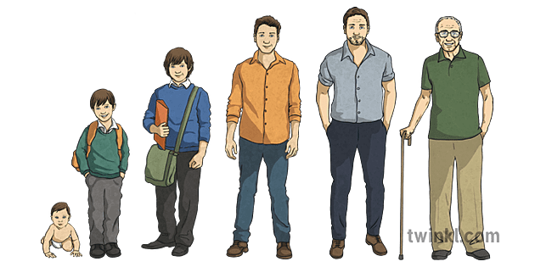
Series: Just Fix It! “Forewarned is Forearmed” (Part 4).
The Problem of Isolation
Long-term Solutions—
Prepare yourself:
Note the changes that go on in others.

Slide 37
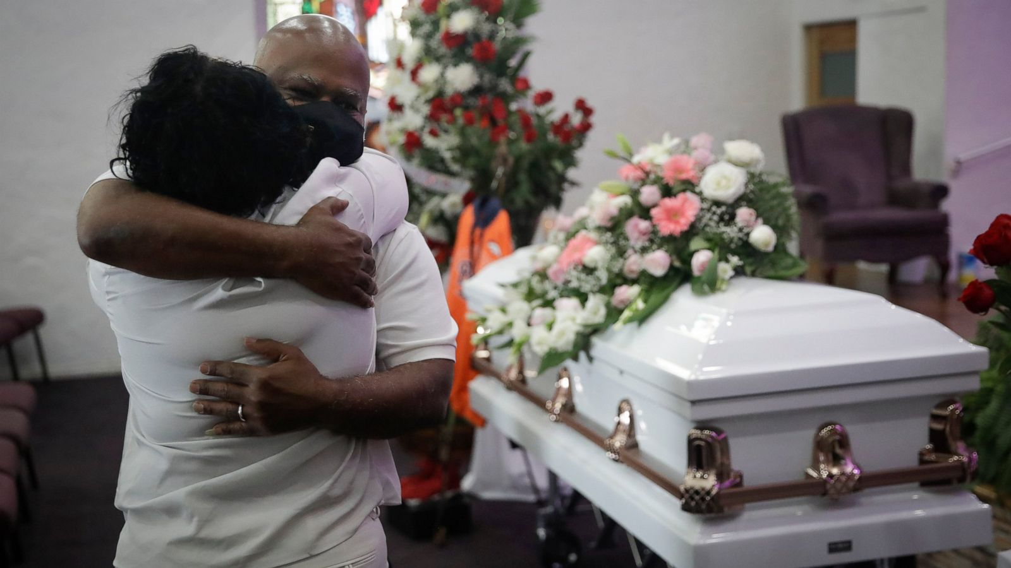
Series: Just Fix It! “Forewarned is Forearmed” (Part 4).
The Problem of Isolation
Long-term Solutions—
Prepare yourself:
Note the changes that go on in others.
Tragedy.

Slide 38
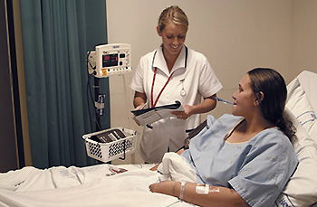
Series: Just Fix It! “Forewarned is Forearmed” (Part 4).
The Problem of Isolation
Long-term Solutions—
Prepare yourself:
Note the changes that go on in others.
Tragedy.
Health.

Slide 39
Series: Just Fix It! “Forewarned is Forearmed” (Part 4).
The Problem of Isolation
Long-term Solutions—
Prepare yourself:
Note the changes that go on in others.
Tragedy.
Health.
Work.

Slide 40
Series: Just Fix It! “Forewarned is Forearmed” (Part 4).
The Problem of Isolation
Long-term Solutions—
Prepare yourself:
Note the changes that go on in others.
Tragedy.
Health.
Work.
Financial setbacks

Slide 41
Series: Just Fix It! “Forewarned is Forearmed” (Part 4).
The Problem of Isolation
Look out for Each other:
1 Thessalonians 5:14— “…encourage the fainthearted, help the weak, be patient with everyone.”

Slide 42
Series: Just Fix It! “Forewarned is Forearmed” (Part 4).
The Problem of Isolation

Slide 43
Series: Just Fix It! “Forewarned is Forearmed” (Part 4).
The Problem of Isolation

Slide 44
Series: Just Fix It! “Forewarned is Forearmed” (Part 4).
The Problem of Isolation
John 15:12

